Slide 1
Presentation 3: Coders
Hannah Ma, Sharon Lin, Ryan Lach, Nathan Jung, Sari Eisen

Slide 2
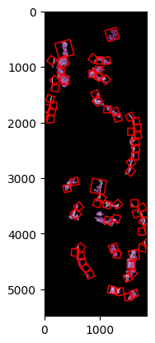
Non-Continuous Epitheliums
The original approach worked best on continuous, circular epitheliums
However some cells have disjointed or even totally separate sections of epithelium
Detect all external contours and apply algorithm along all exterior
This approach allows the algorithm to handle more complex shapes
Contour hierarchy
This is information on how contours exist in relation to one another
May allow for more advanced approaches to complex cells
Notes:
Ryan

Slide 3
contours, hierarchy = cv2.findContours(binary_image,
cv2.RETR_EXTERNAL,
cv2.CHAIN_APPROX_SIMPLE
)

Slide 4
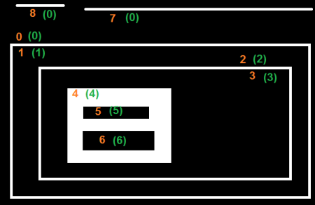
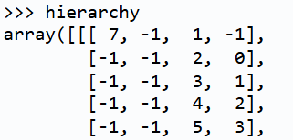
Attempt to Manipulate Contour Hierarchy
Take advantage of CV2’s built-in capabilities for tracking nested contours
[Next, prev, child, parent]
We want
Donuts (no siblings, single child)
Islands (no parent, no child)

Slide 5
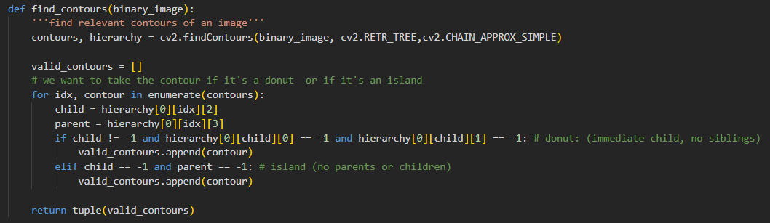

Slide 6
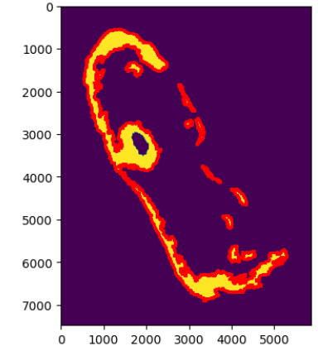
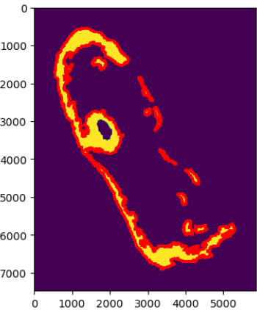
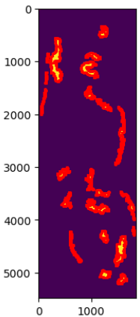
Performs just as well as RETR_EXTERNAL for most…
Hierarchy logic RETR_EXTERNAL
Hierarchy logic RETR_EXTERNAL

Slide 7
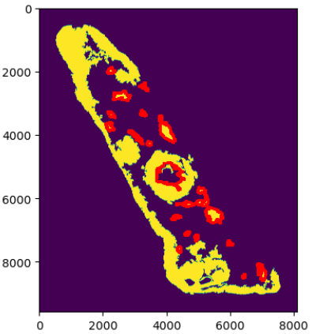
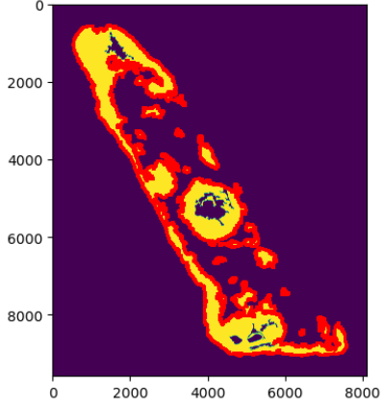
… fails miserably for others (😭)
Next steps:
Use different retrieval algorithm
Implement size threshold
Hierarchy logic RETR_EXTERNAL

Slide 8
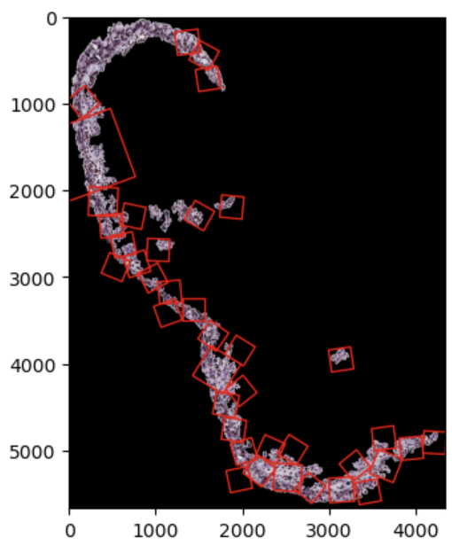
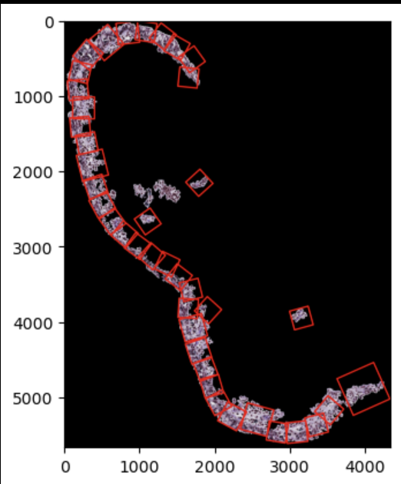
Parameter Optimization
Set Parameters have a large impact on the final patching of a cell
This is especially pronounced on difficult cells to patch
A basic Grid Search allows for rudimentary parameter tuning
Tuned on a score metric made of % Epithelium patched and black pixels in patches
Potential next step:
Improving score function/evaluation metrics
Looking for additional aspects to parameterize
Notes:
Ryan

Slide 9
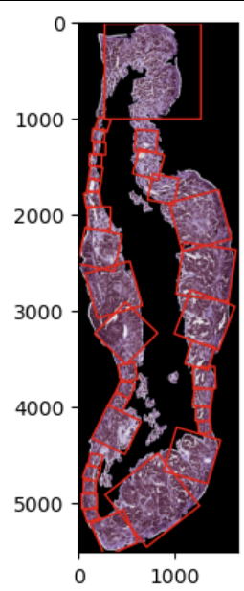
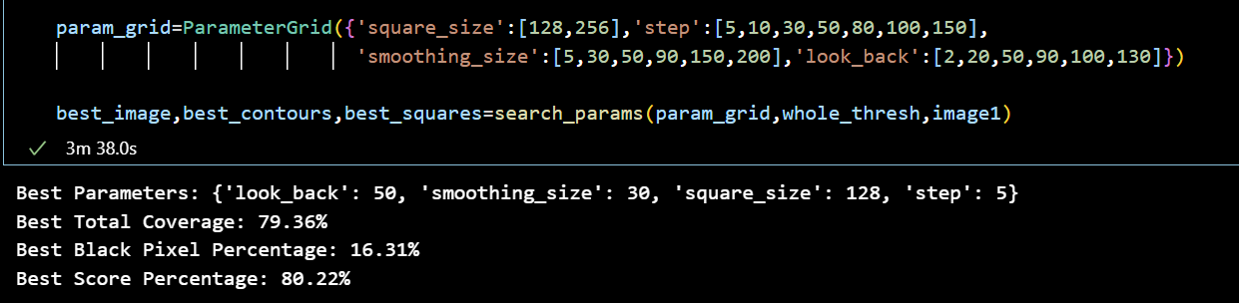
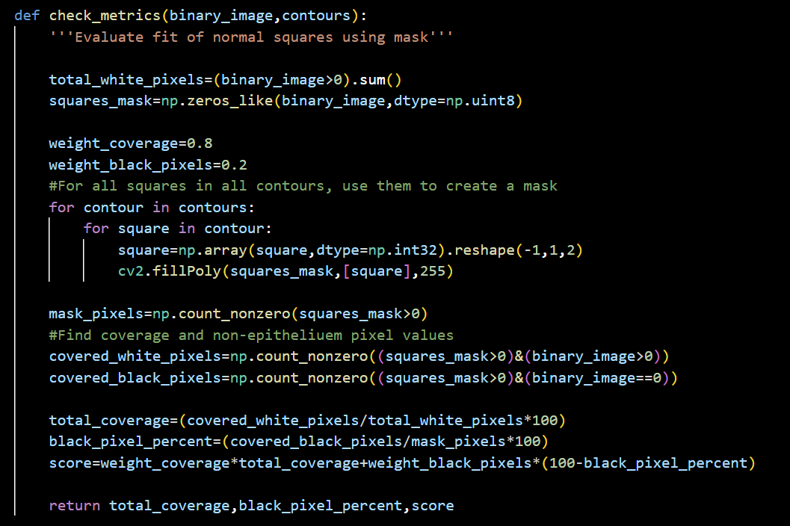
Notes:
Ryan

Slide 10
Debugging: Epithelium Width
Problem: Some patches don't cover the entire epithelium width … but what does “cover epithelium width” mean?
Current Definition: increase size of patch from 128x128 until point opposite of tangent point along contour is outside epithelium, or until size of patch is 1024x1024
Alternative Definitions:
At least two opposite corners are outside epithelium
At least two points on opposite sides of patch are outside epithelium
At least two points on any two sides of patch are outside epithelium
Notes:
Sharon

Slide 11
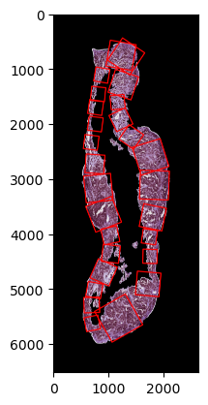
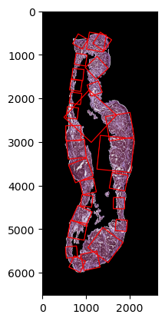
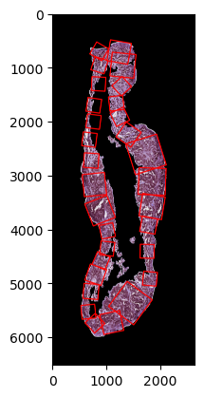
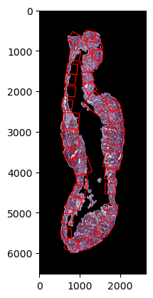
current
1
2
3

Slide 12
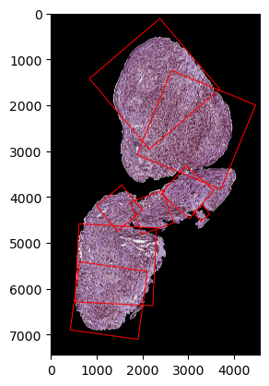


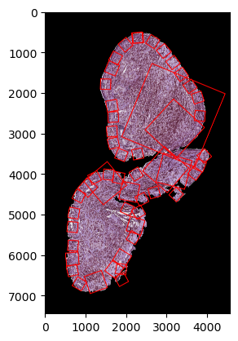
current
1
2
3

Slide 13
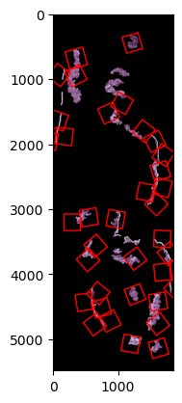
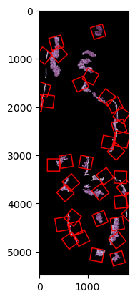

current
1
2
3

Slide 14
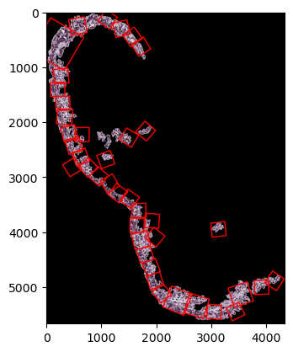
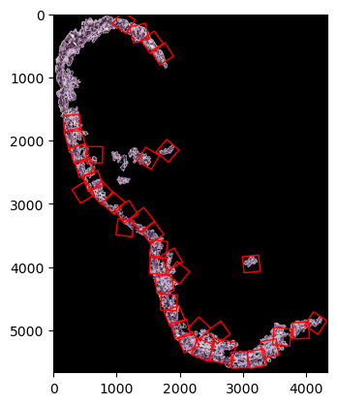

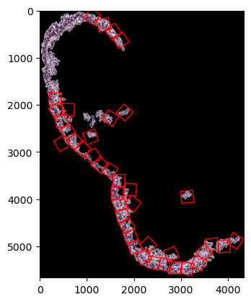
*there seems to be a recurring issue with patching by the boundary of the image
current
1
2
3

Slide 15
Debrief
Alternative Definitions:
At least two opposite corners are outside epithelium
Too strict!
At least two points on opposite sides of patch are outside epithelium
Seems to be the most reasonable
At least two points on any two sides of patch are outside epithelium
Too lenient!
Thinkers – any alternative definitions we should try?
Notes:
Sharon

Slide 16
Implementing and testing updated code
Epithelium not continuous
Epithelium multi-branched
Epithelium wider than square size
Epithelium with rapidly varying width
Any other edge cases?
Notes:
Sari

Slide 17
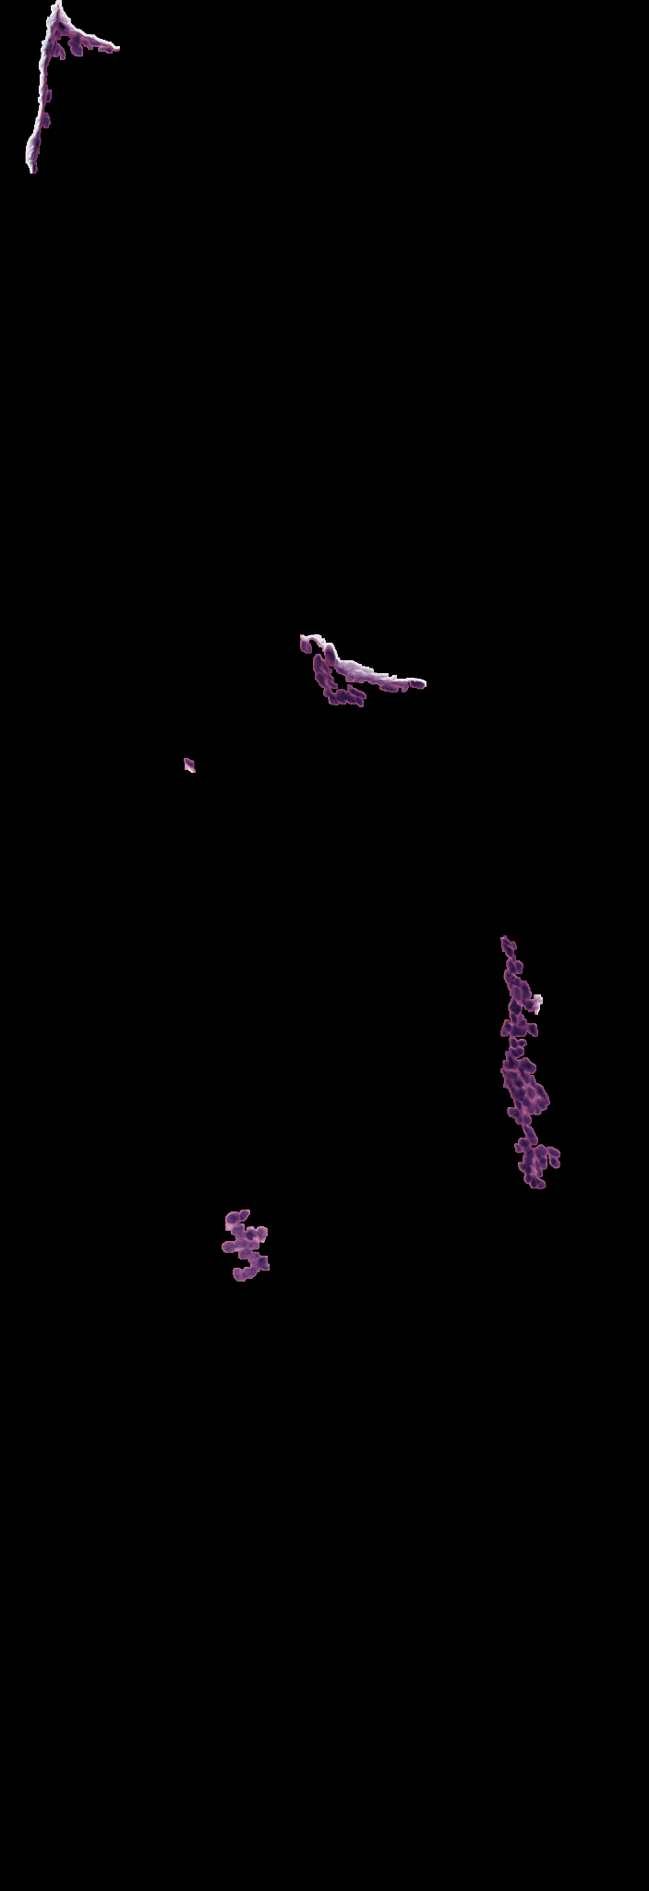
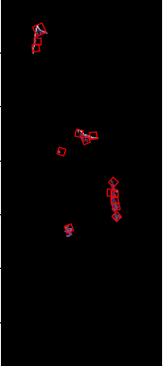
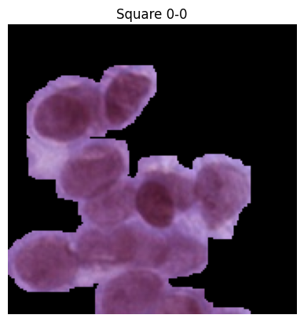
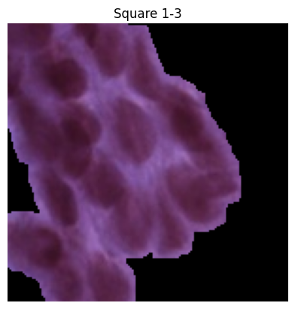
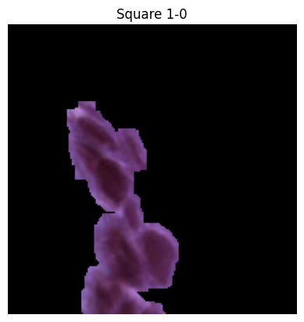
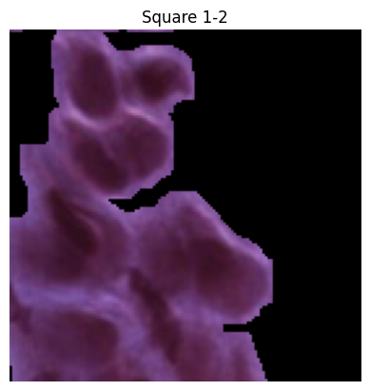
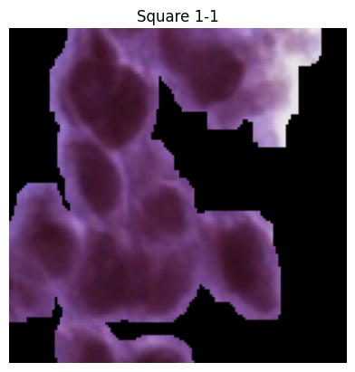
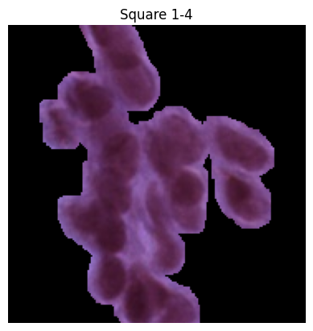
Patchy epithelium example
Notes:
Sari

Slide 18
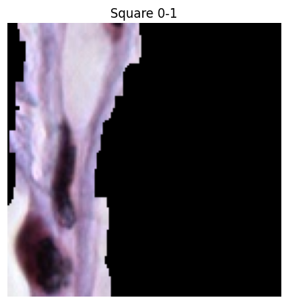
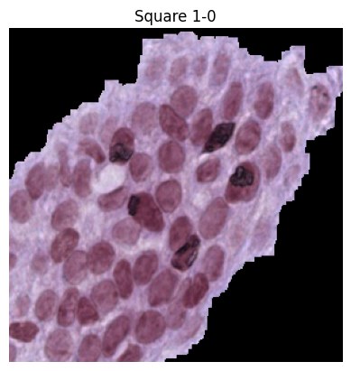
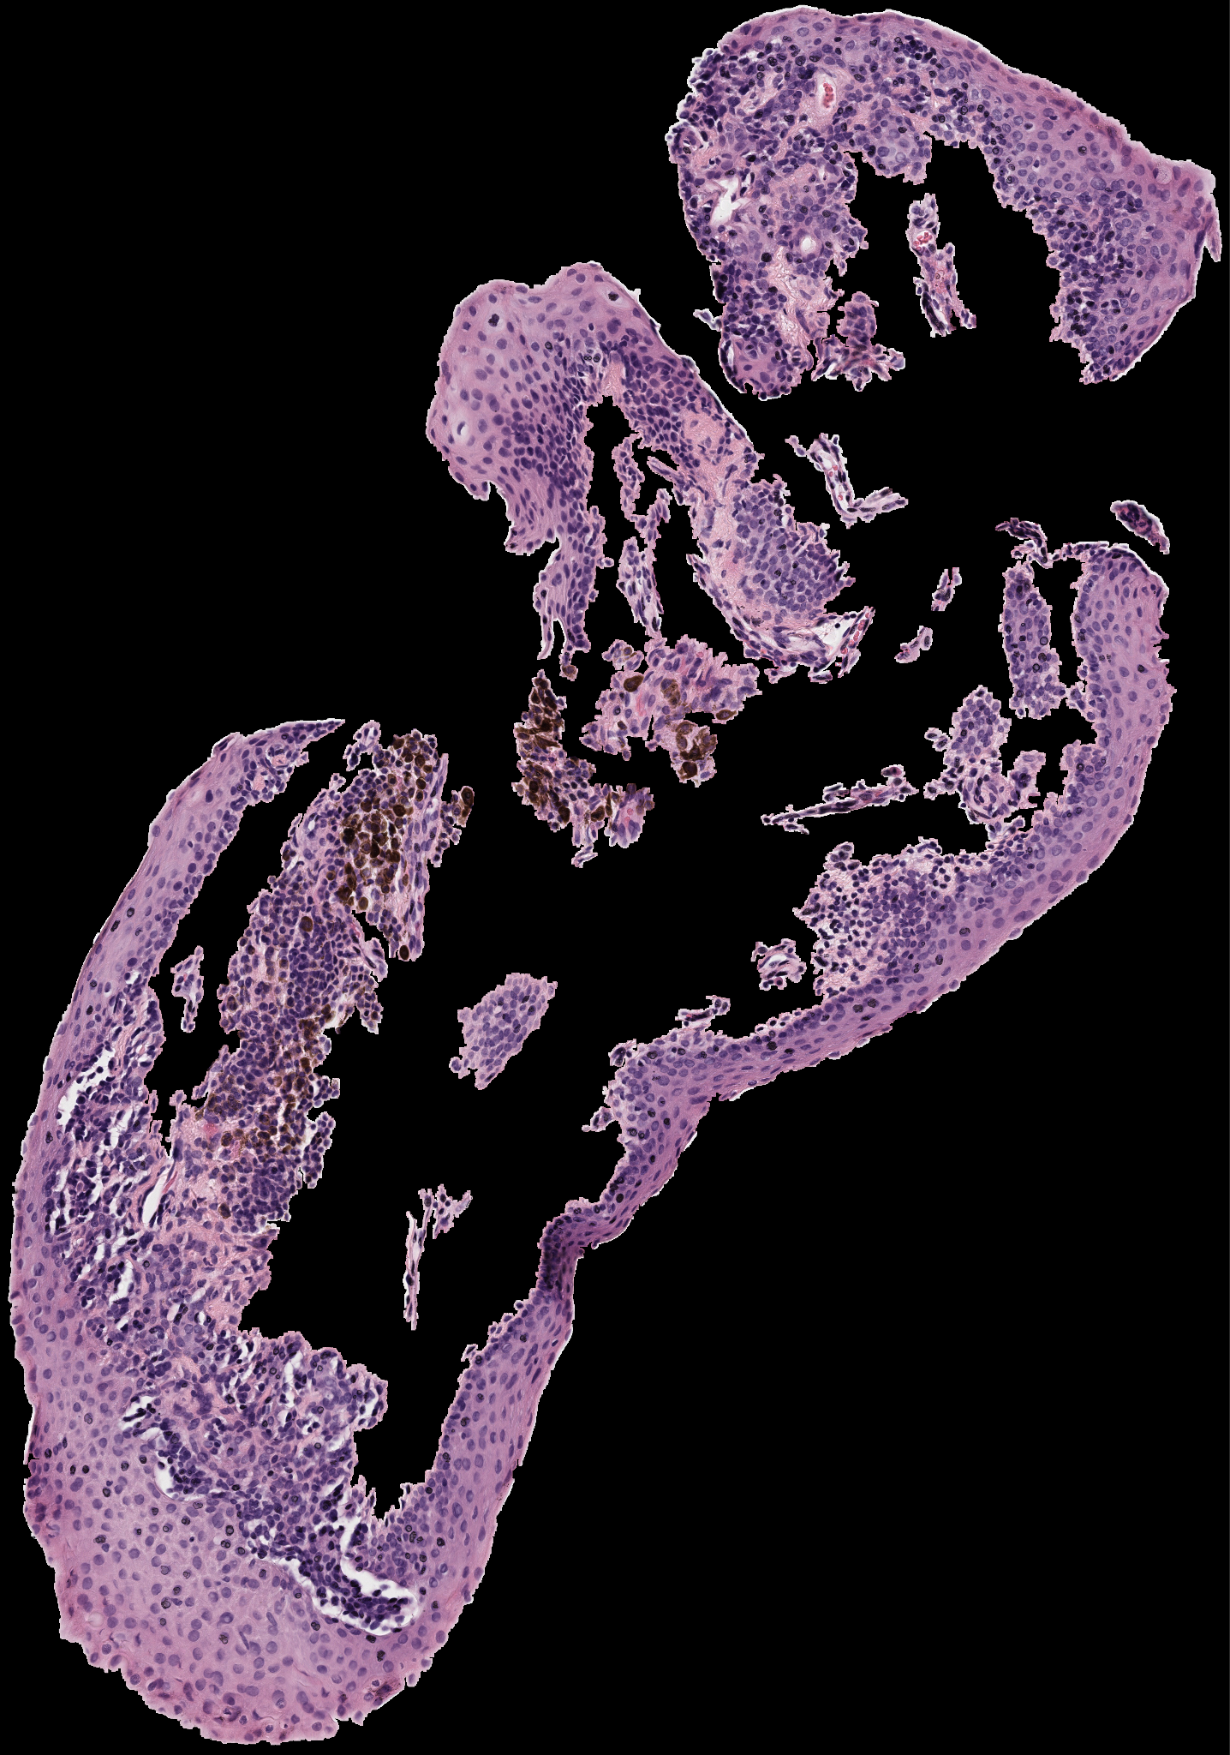
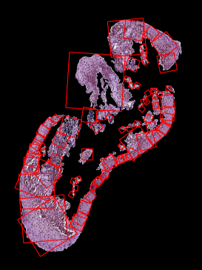
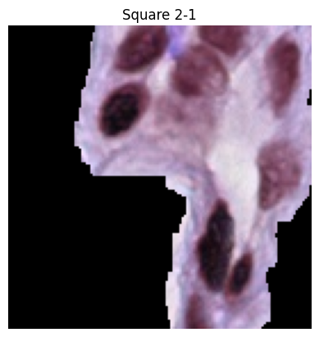
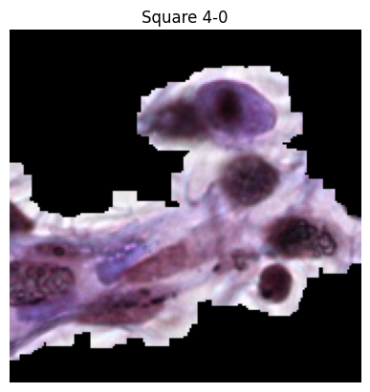
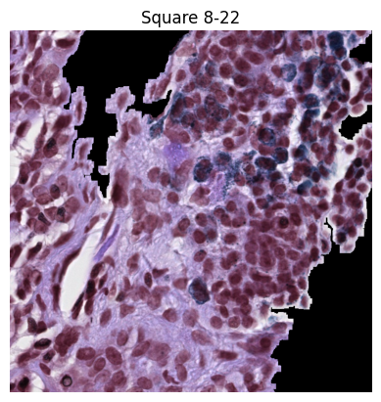
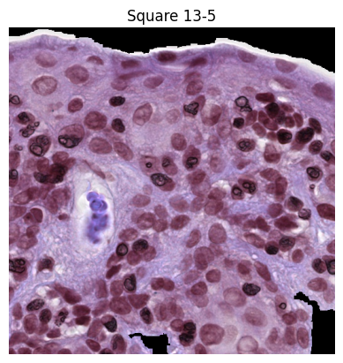
Branched epithelium example
Notes:
Sari

Slide 19
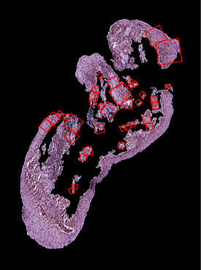
Losing squares with second pass
Notes:
Sari

Slide 20
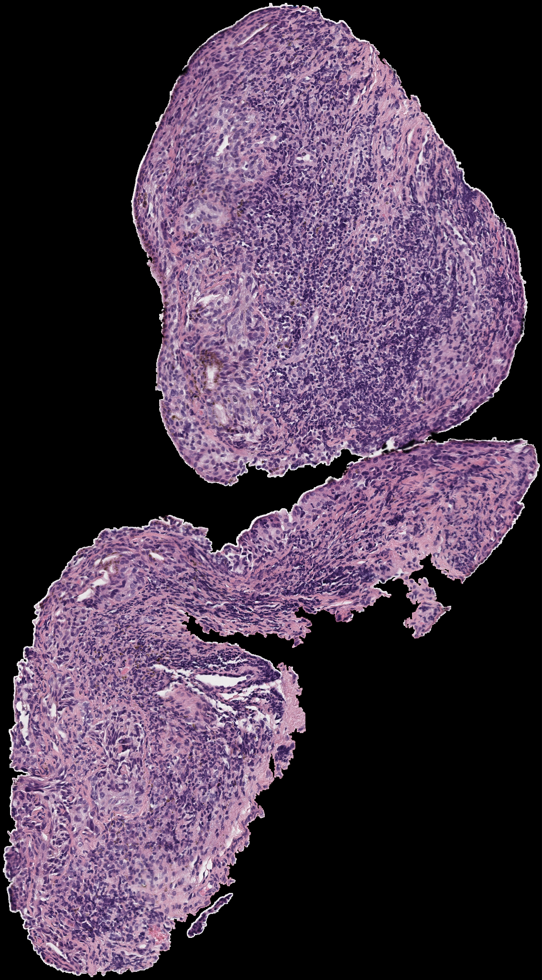

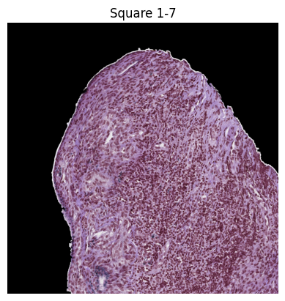
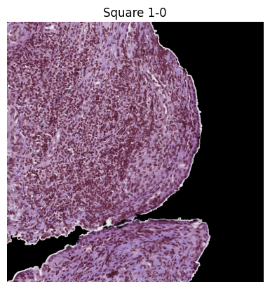
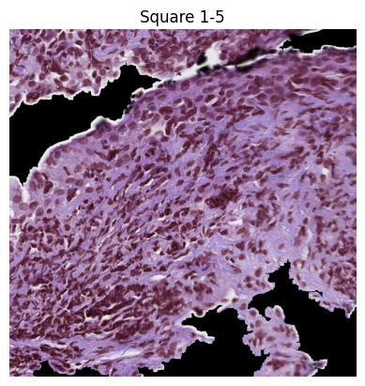
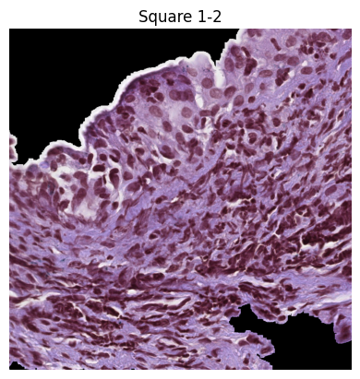
Wide epithelium example
Notes:
Sari

Slide 21
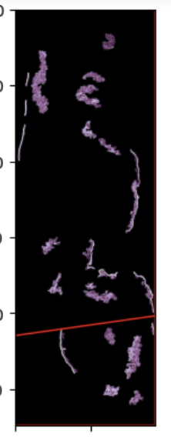
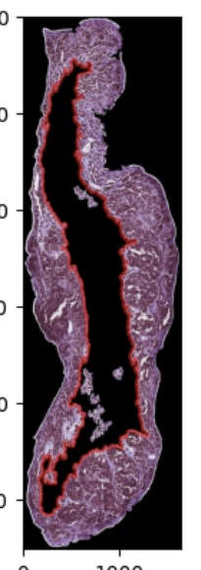
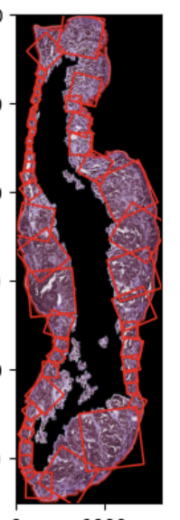

Secondary Attempt
Notes:
Had an idea to use a secondary contour that is meant to find the “inner” portion of the epithelium to then find the closest point to that inner line from the outer contour and draw a box depending on that width that is created. Some issues that could have been kinked out with some more coding and solutions, but once Ryan came out with his new version of his code I decided this wasn’t worth pursuing.

